Slide 1

EPIDEMIOLOGY ANALYSIS PROBLEM
diagram
history
goals
analysis
problem
objective

Slide 2
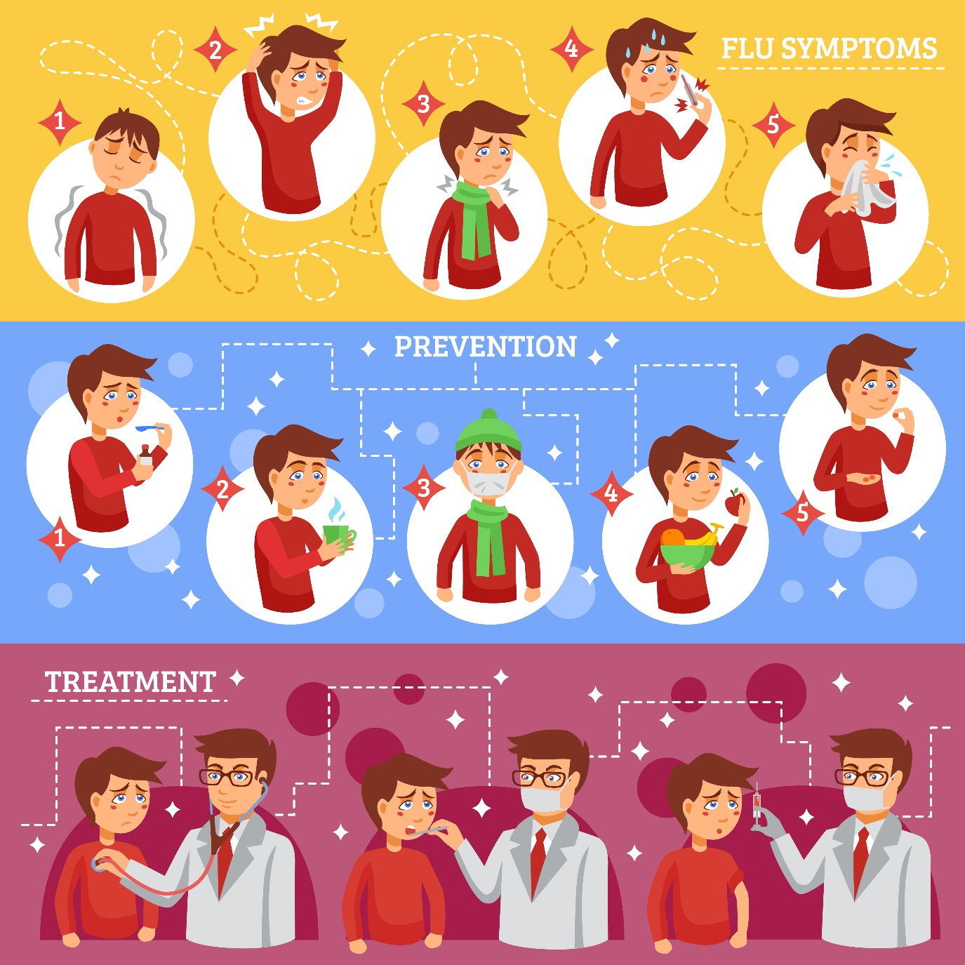
diagram
history
goals
analysis
problem
objective

Slide 3



2015
2018
2019
1
2
3
diagram
SWINE FLU
NIPHA VIRUS
ENCEPHALITIS
history
goals
analysis
problem
objective
Outbreak in Gujarat
Outbreak in Kerala
Outbreak in Bihar

Slide 4
history
diagram
analysis
goals
problem
objective

Slide 5

Smart solutions
Support Citizens
Assist Policy Makers
Better Health Services
diagram
history
goals
analysis
problem
objective

Slide 6

GOALS
Better Idea of Affected People
Medication Support
Better health services
Understanding of analysed data
diagram
goals
history
analysis
problem
objective

Slide 7
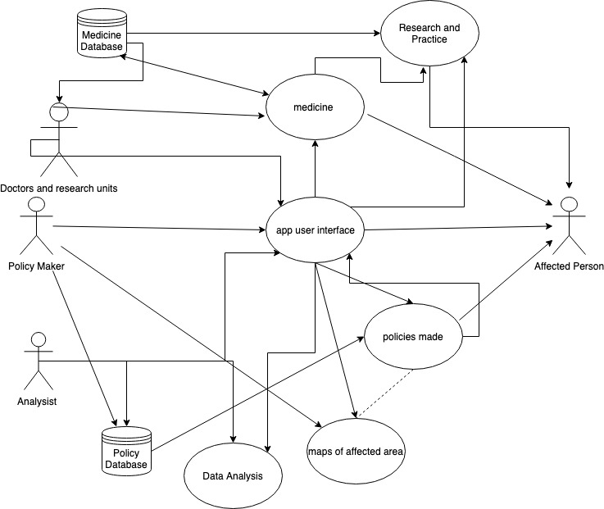
UML Diagram

Slide 8
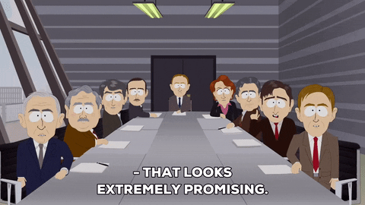
POLICY MAKER
Makes policy for general masses
Responsible for making rules for disease control
Analysing the situation based on data

Slide 9

AFFECTED PERSON
Person affected by disease
Data of affected person is stored in database

Slide 10
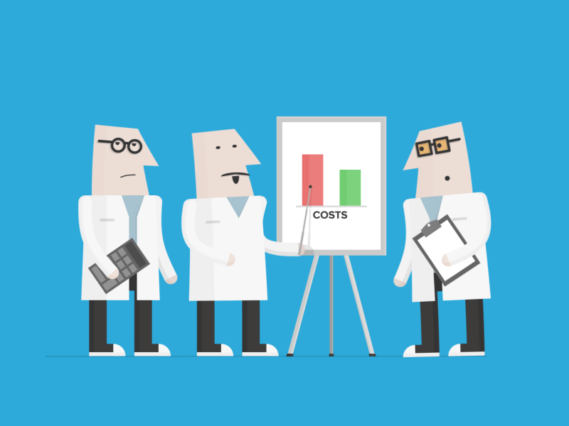
ANALYST
Primary deal with patient records
Create statistical data and reports
Reports guide healthcare organisations

Slide 11
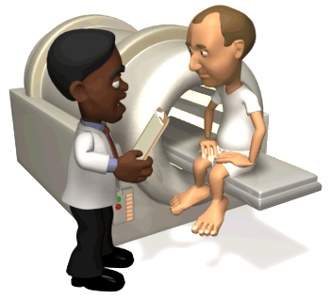
DOCTOR & RESEARCH UNITS
Professional who practice medicine
Doctors can use the app to study the pattern
Could work to improve the condition

Slide 12

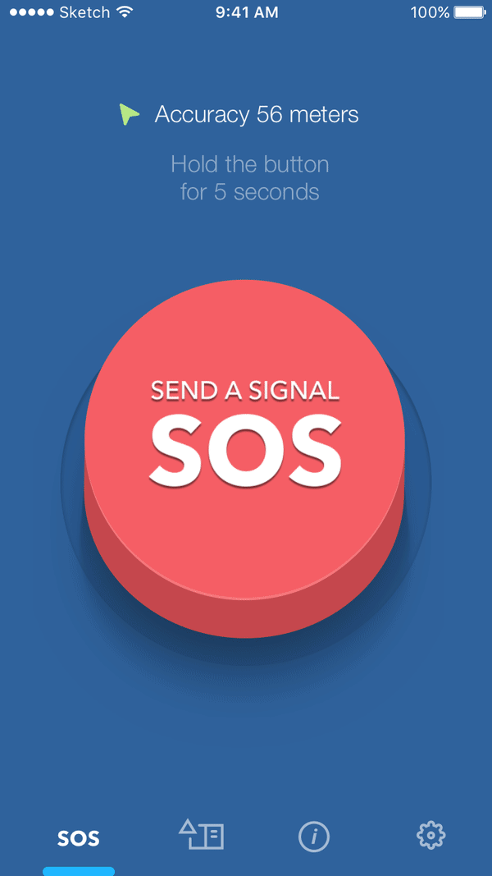
UNIQUE FEATURES OF OUR APP & WEBSITE:
Chat bot using dialog flow
Video call support
SOS
Medical files & history in a single QR code
Full bio-data using aadhar card number

Slide 13

SOFTWARE & TECHNOLOGIES USED.
Flutter. for the android and iOS app to have uniformity.
Mongo db , mochajs , mongoose for the backend
Leaﬂet js for web map api
Google Map api for ﬂutter map
Google Big Data Analytics

Slide 14


